Slide 1







ANALYSIS OF CURRENT AND FUTURE TECHNOLOGY
SIDDHARTH SINGHAL
23/12/2020

Slide 2



OUTLINE
Executive Summary
Introduction
Methodology
Results
Visualization – Charts
Dashboard
Discussion
Findings & Implications
Conclusion
Appendix

Slide 3

EXECUTIVE SUMMARY
LANGUAGE
Javascipt is popular language this year as well as next year
Python will become the 2nd popular language next year
Database
PostgreSQL will be on 1st position next year
Redis and ElasticSearch will be included in the top 5 database next year
Platform and WebFrame
Linux and Windows are top platform this year but Docker users will increase next year.
This year,Users of Jquery WebFrame are More
There is a big difference in gender.

Slide 4

INTRODUCTION
This report is going to give an overview of popular languages and databases used nowadays, as well as the trend for the languages and databases
Programmers could gain an insight from this report for developing their language skills

Slide 5

METHODOLOGY
2019 Stack Overflow online survey of software professionals was used for dashboard creation
GitHub Webpage Job Postings used for analysis or the current trends for job profile needs
Data analysis
Descriptive statistics

Slide 6
RESULTS
Visualization of Data
Programming Language Trend and Its Salary
Database Trend and Its Implication
Dashboard
Link of Dashboard
Screenshot of Dashboard Tabs

Slide 7
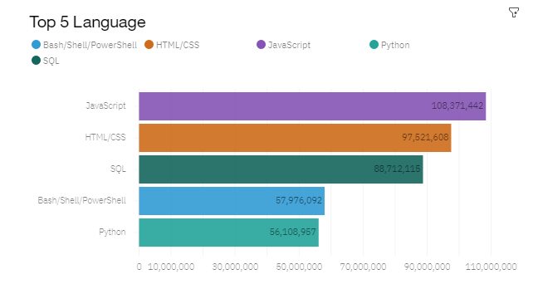
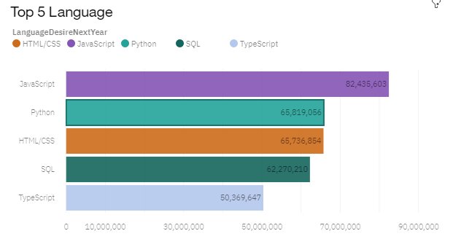
PROGRAMMING LANGUAGE TRENDS
Current Year
Next Year

Slide 8
PROGRAMMING LANGUAGE TRENDS - FINDINGS & IMPLICATIONS
Findings
JavaScript is a popular language this year as well as next year but no. of users is declined in next year.
Python will become the second popular language next year
Typescript will replace the PowerShell in next year
Implications
Users should learn JavaScript and Python for next year
Typescript is also important in next year because it take 5th place.

Slide 9
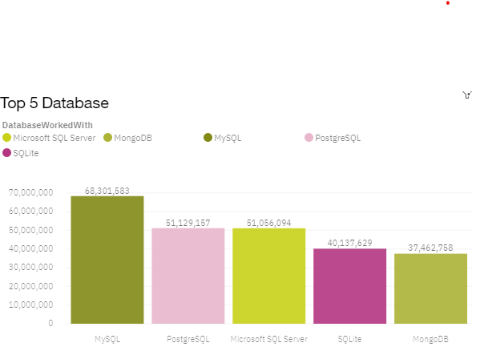
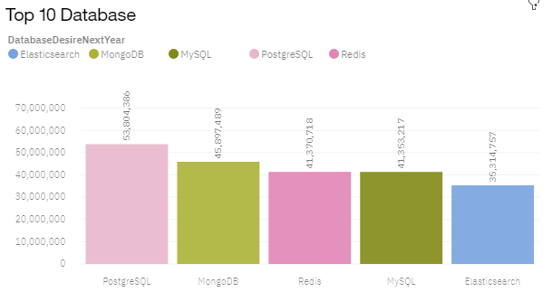
DATABASE TRENDS
Current Year
Next Year

Slide 10
DATABASE TRENDS - FINDINGS & IMPLICATIONS
Findings
MySQL is popular database this year but in next year PostgreSQL is popular.
Redis and Elasticsearch will gain more users in the next year
MongoDb will become more users in next year
Implications
Redis and Elasticsearch are going to be popular in next year so users need to pay attention
Master in PostgreSQL is important.

Slide 11

DASHBOARD
https://eu-gb.dataplatform.cloud.ibm.com/dashboards/848fe760-9df1-4a3b-b089-6162a06ca09c/view/5719fe3564ef32f754e8b5e407982e027862255bb2bbd75586857b495b337697a83f1699c87e4d5dd914076aa7ee175998

Slide 12
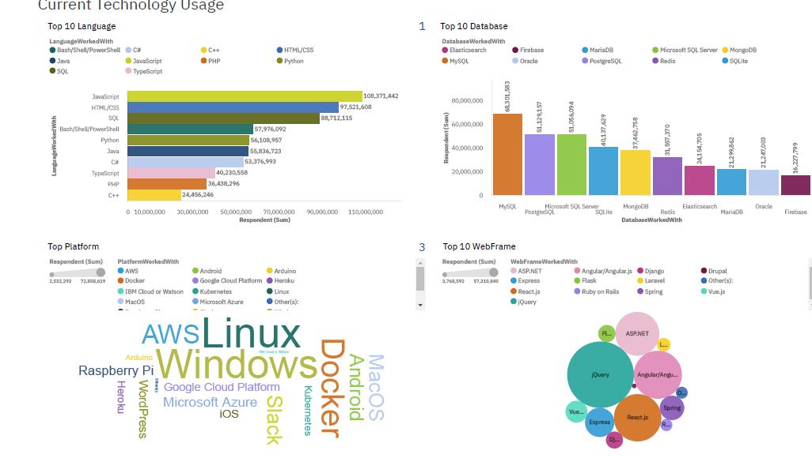
DASHBOARD TAB 1
– CURRENT TECHNOLOGY

Slide 13
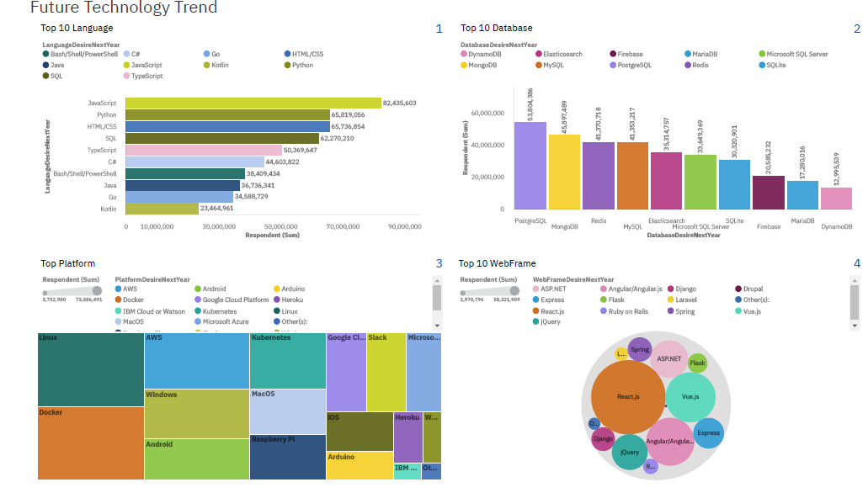
DASHBOARD TAB 2
– TECHNOLOGY TREND

Slide 14
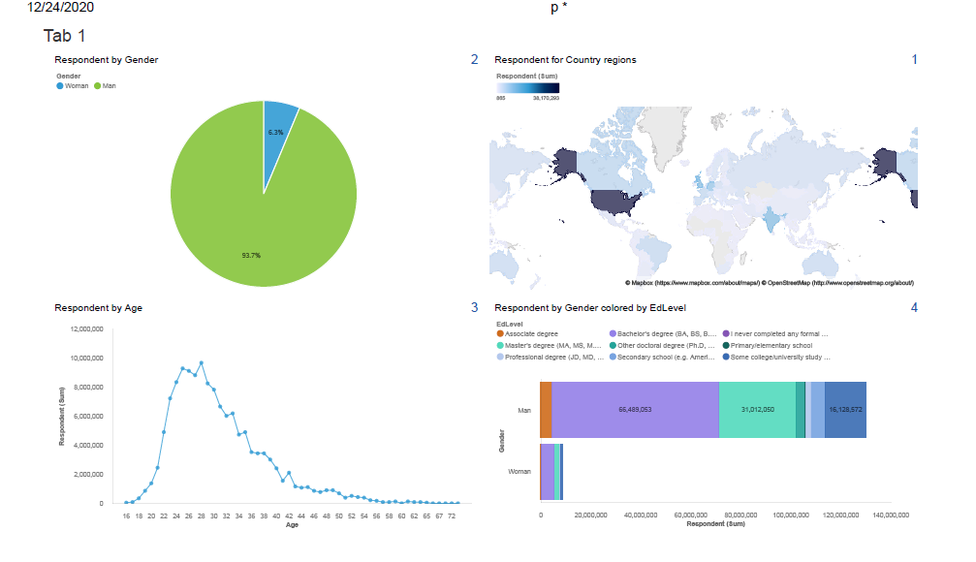
DASHBOARD TAB 3
– RESPONDENT DISTRIBUTION

Slide 15
DISCUSSION
Why is there such a large gender difference in education level?
Why do people leave MySQL and move to PostgreSQL?

Slide 16
OVERALL FINDINGS & IMPLICATIONS
Findings
JavaScript is a popular language this year as well as next year.
PostgreSQL will become the top database next year so programmers need to learn .
Linux users are more this year and will be more next year.
Windows users will decrease next year and Docker users will increase.
There are more man respondents compare to woman .
Most people are doing Bachelor degrees.
Implications
Programmers should learn JavaScript and Python because it is going to be popular next year
Programmers has to change your skills over time
language and database technology are also need to be promoted among woman to eliminate the gender difference

Slide 17

CONCLUSION
Javascript is a popular language this year as well as next year.
Swift and Python language have the highest salaries
PostgreSQL will become the top databse next year so programmers need to learn .
Windows users will decrease next year and Docker users will increase.
We have seen a huge gender difference in Education level

Slide 18
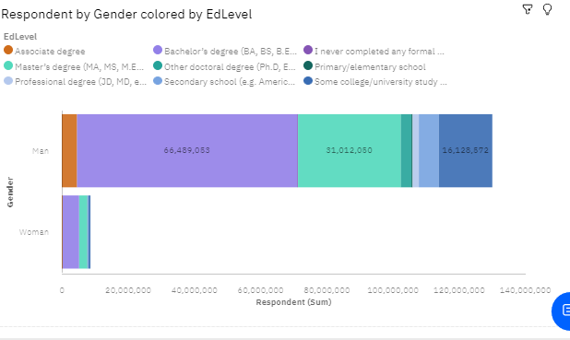
APPENDIX

Slide 19
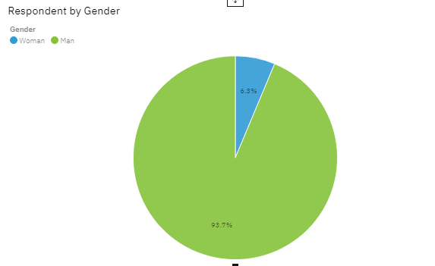

Slide 20
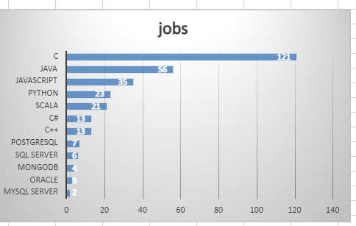
GITHUB JOB POSTINGS

Slide 21
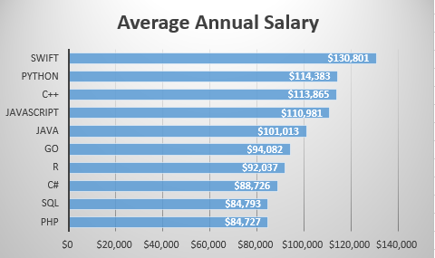
POPULAR LANGUAGES

